Slide 1
Fake news detection with R
Vinay Bhandaru

Slide 2
Kaggle fake news dataset
https://www.kaggle.com/datasets/emineyetm/fake-news-detection-datasets
21,417 Real-News articles collected from Reuters.com
23,481 Fake News articles collected from unreliable websites flagged by Politifact
The majority of articles are about politics and world news
Examples of fake news websites flagged by Politifact
16WMPO.com
24online.news
24wpn.com
24x365live.com
247NewsMedia.com
a-news24.com
https://www.politifact.com/article/2017/apr/20/politifacts-guide-fake-news-websites-and-what-they/

Slide 3
Fake new detection
Goal was to build a logistic regression model to detect fake news articles using the tidytext and other R packages to calculate these measures
Use the unnest_tokens() function from tidytext to tokenize the text into words and then calculate word frequencies in each article. The frequencies and proportions are then used to predict whether an article is real or fake.
Number and proportion of stop words, which are frequently used words like "a," "the," "is," and "and"
Number and proportion of negative words
Number and proportion of positive words
Number and proportion of words only common in fake news
Number and proportion of words only common in real news

Slide 4
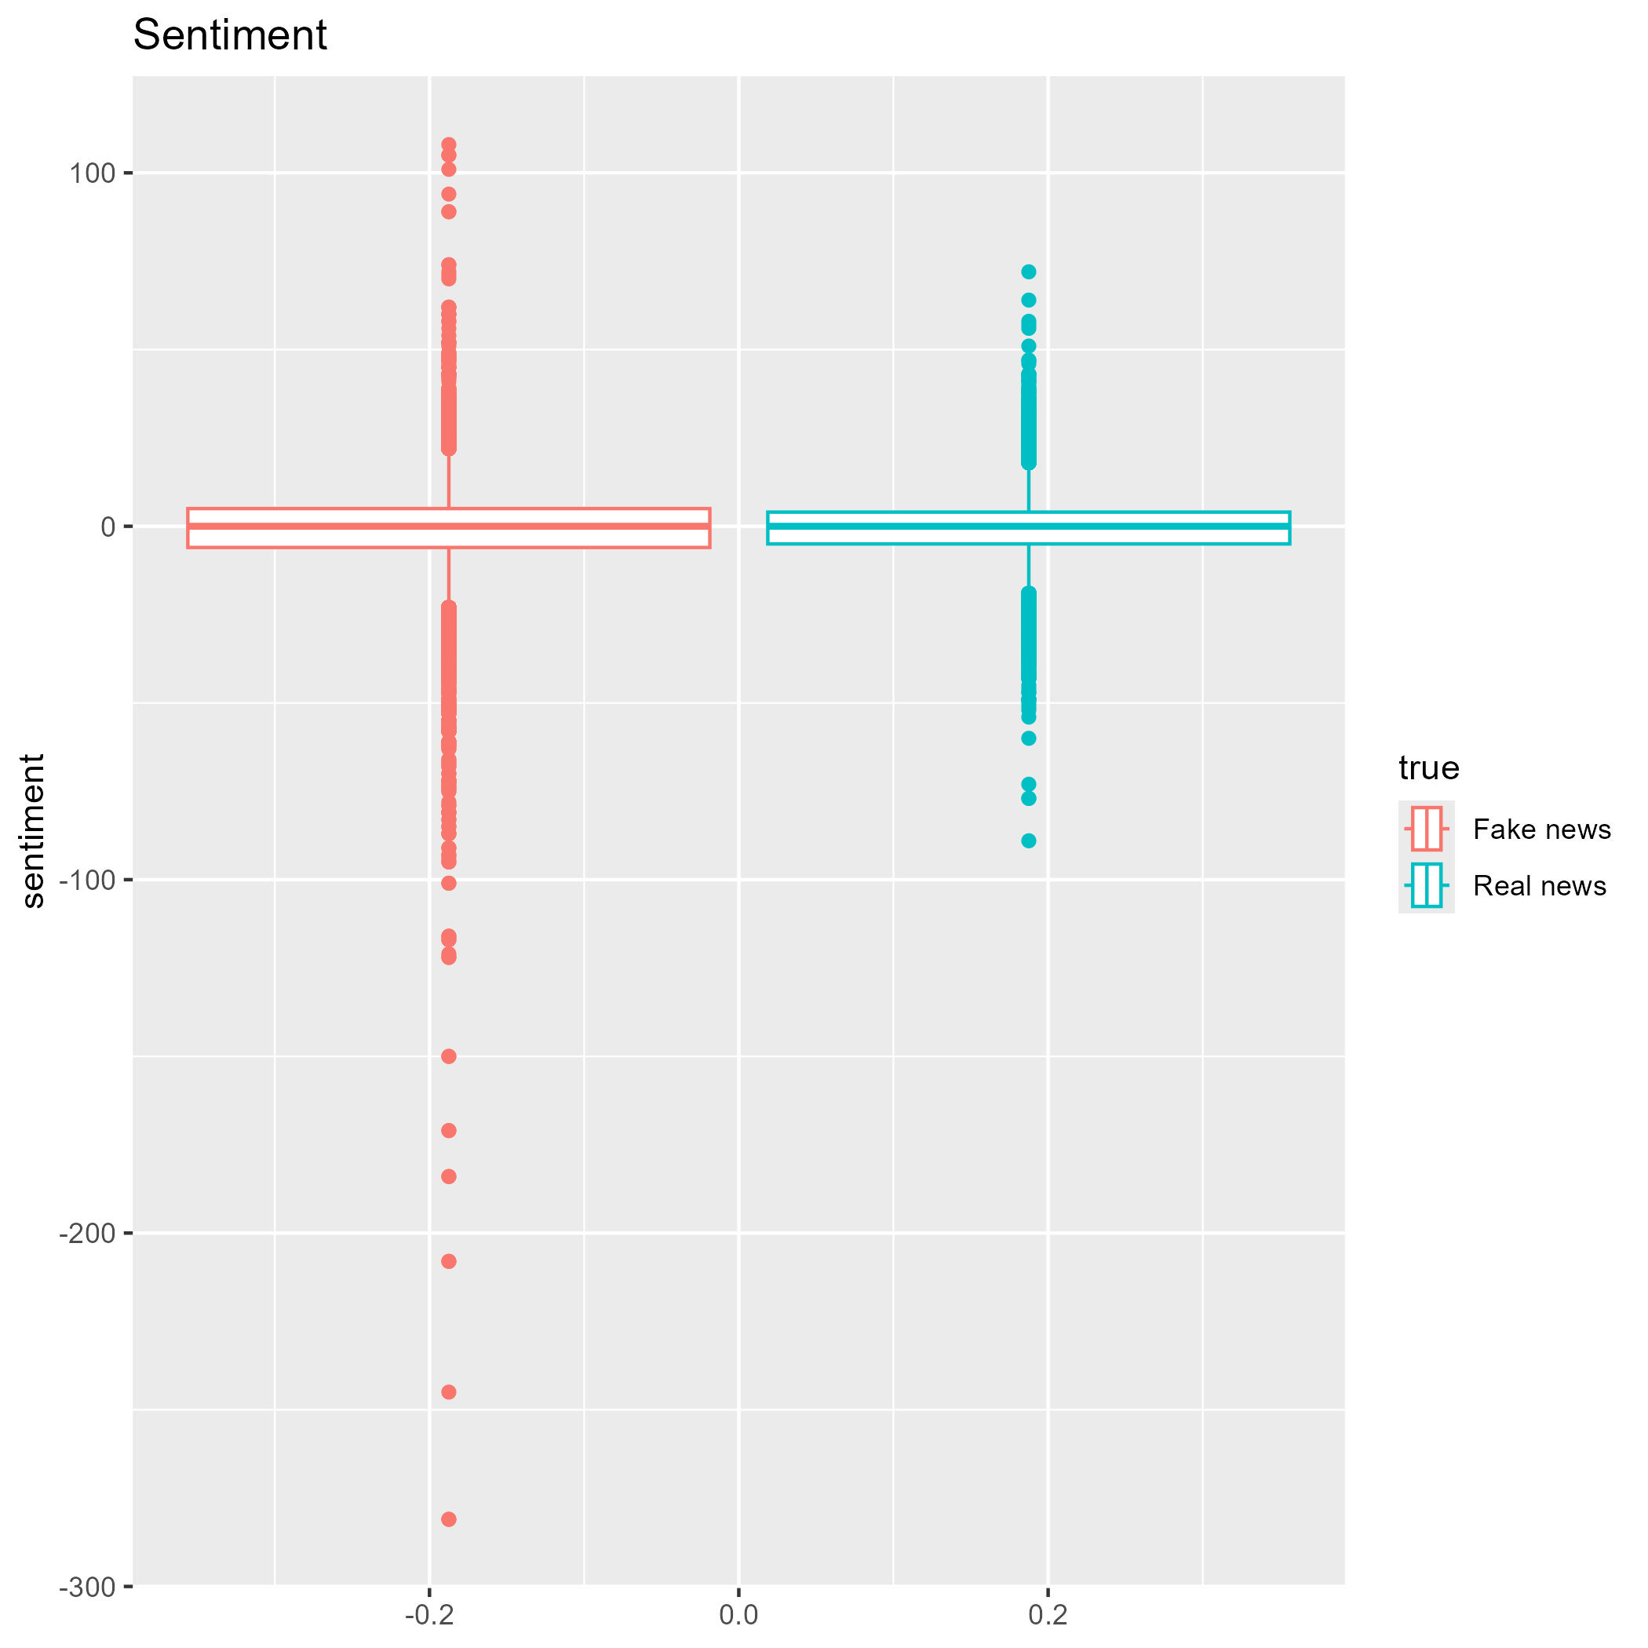
Positive and negative words
Sentiment is the difference between the number of positive words and negative words in an article
Both types of articles had a negative mean sentiment score, but fake news articles were more negative on average
 | Mean | Standard Dev. | Median | Minimum | Maximum
Fake news | -1.24 | 12.55 | 0 | -281 | 108
Real news | -0.57 | 9.41 | 0 | -89 | 72

Slide 5
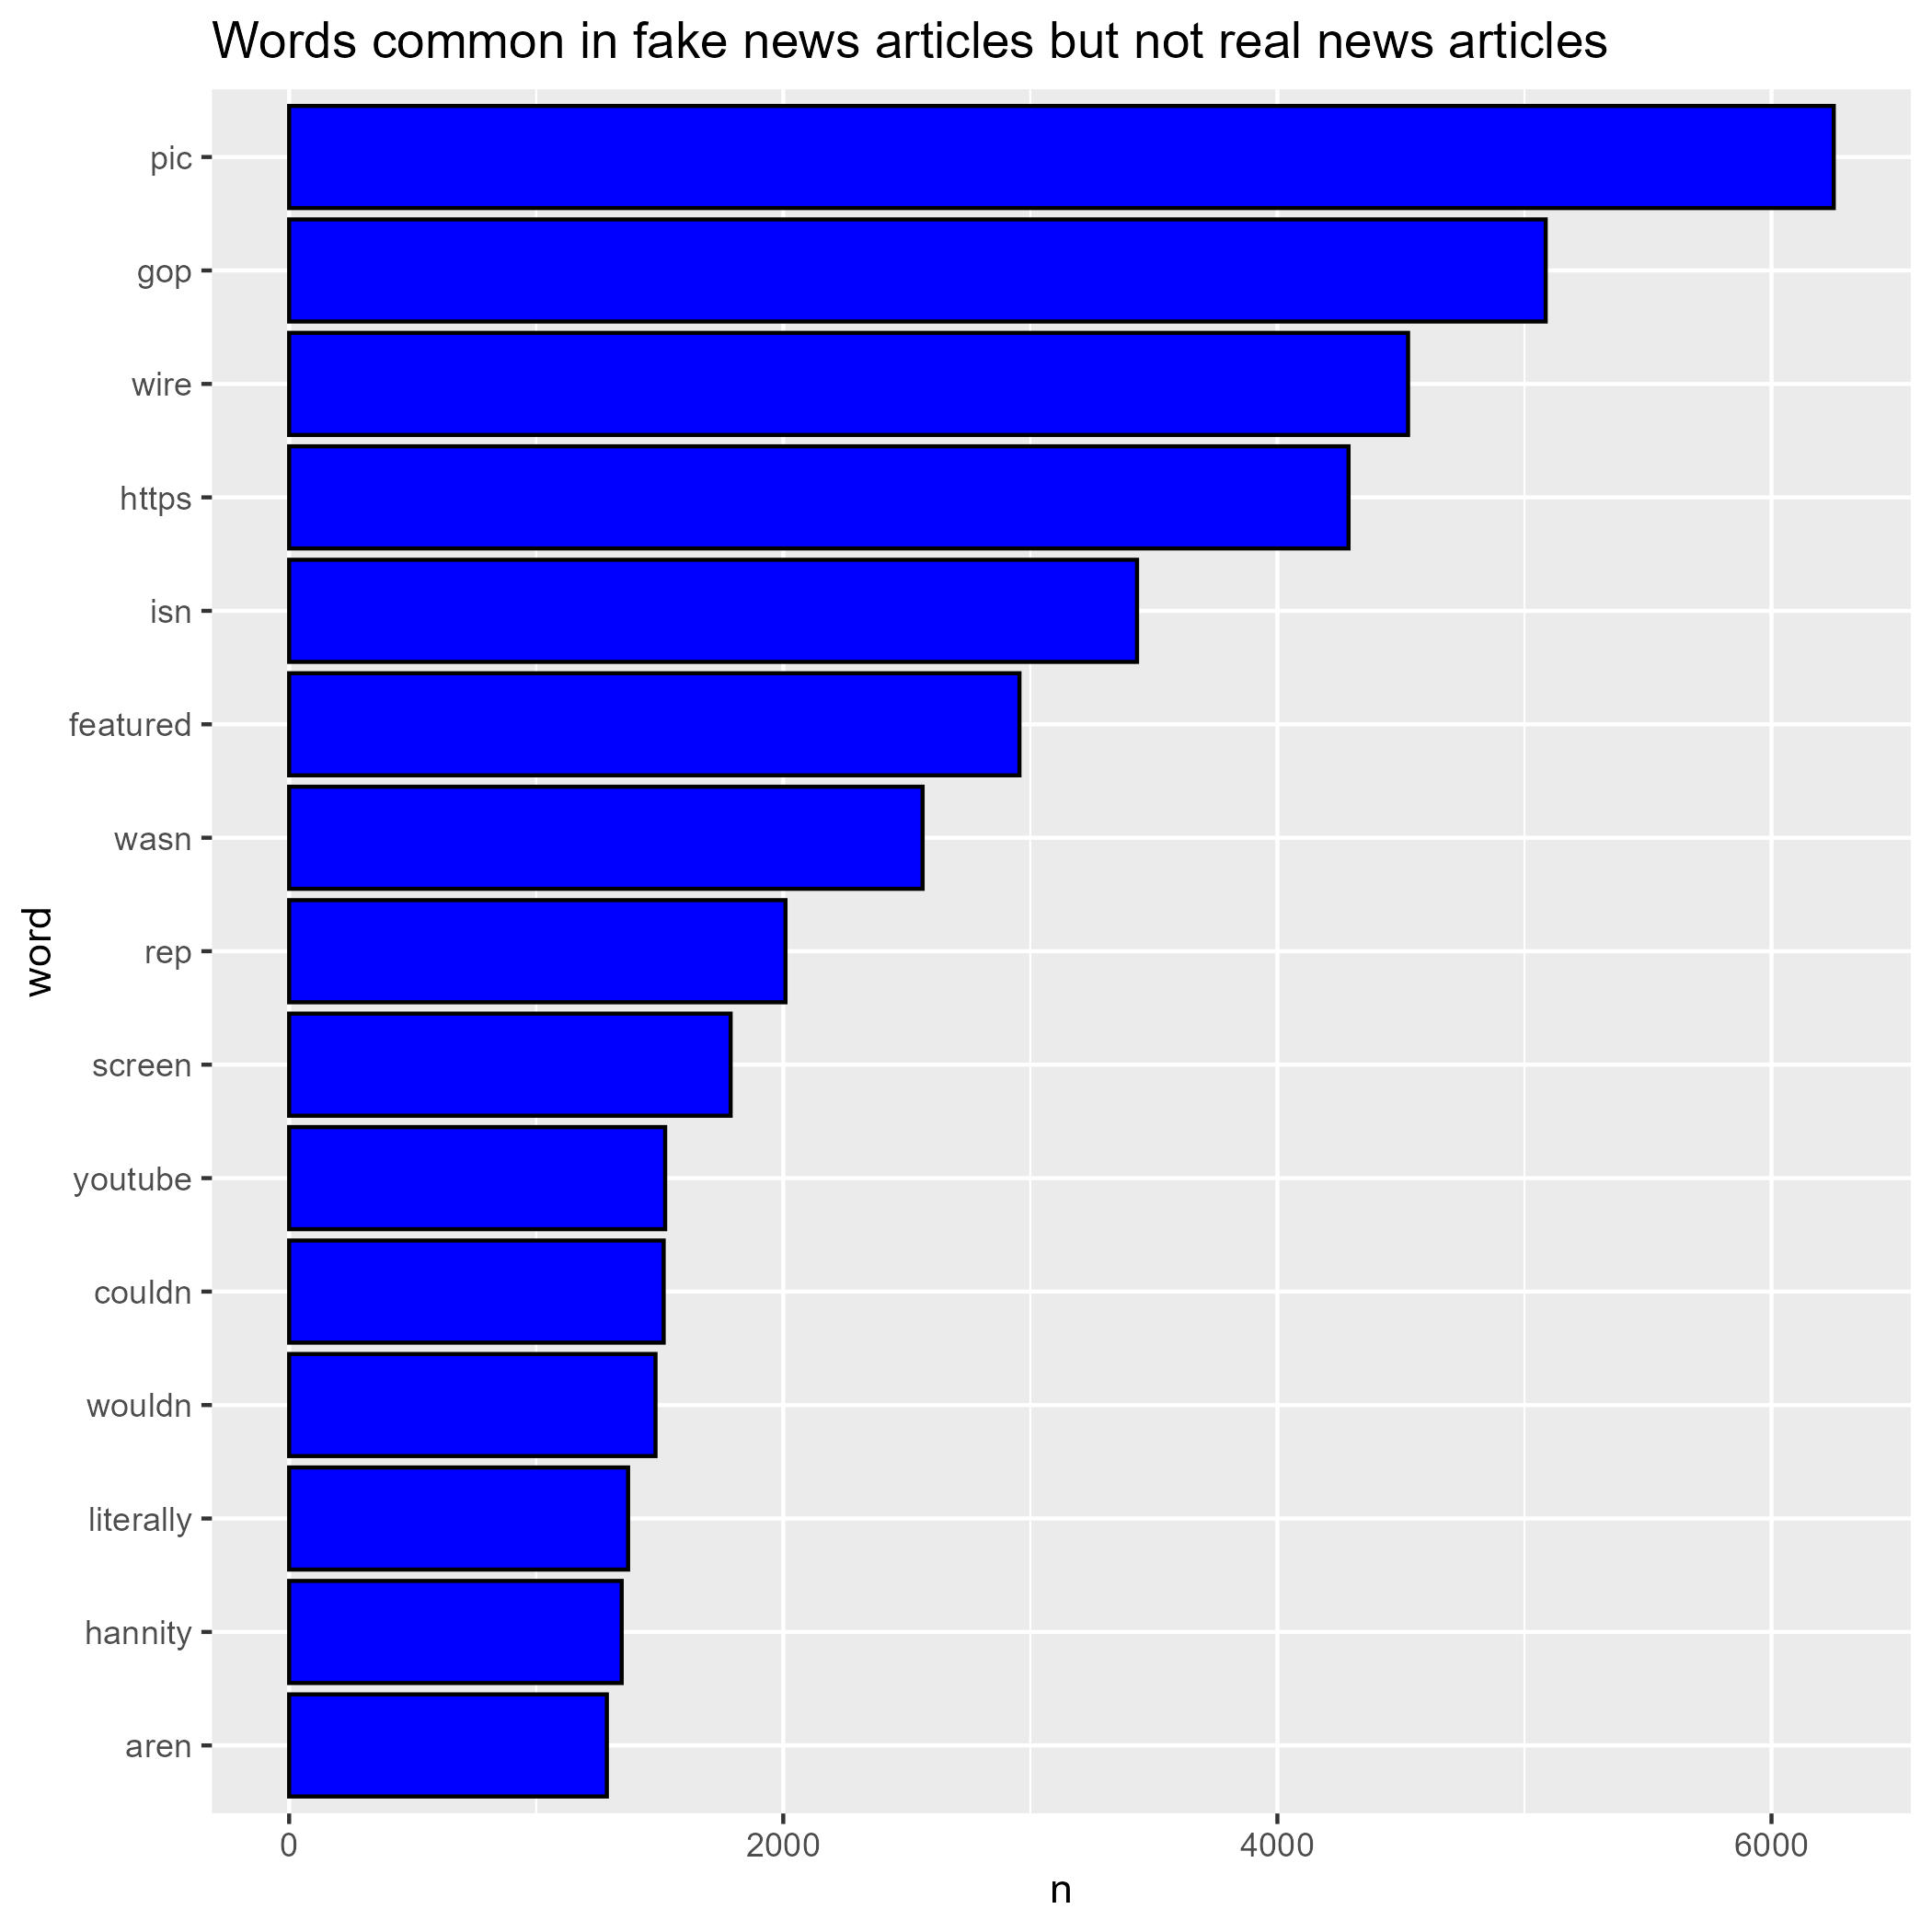
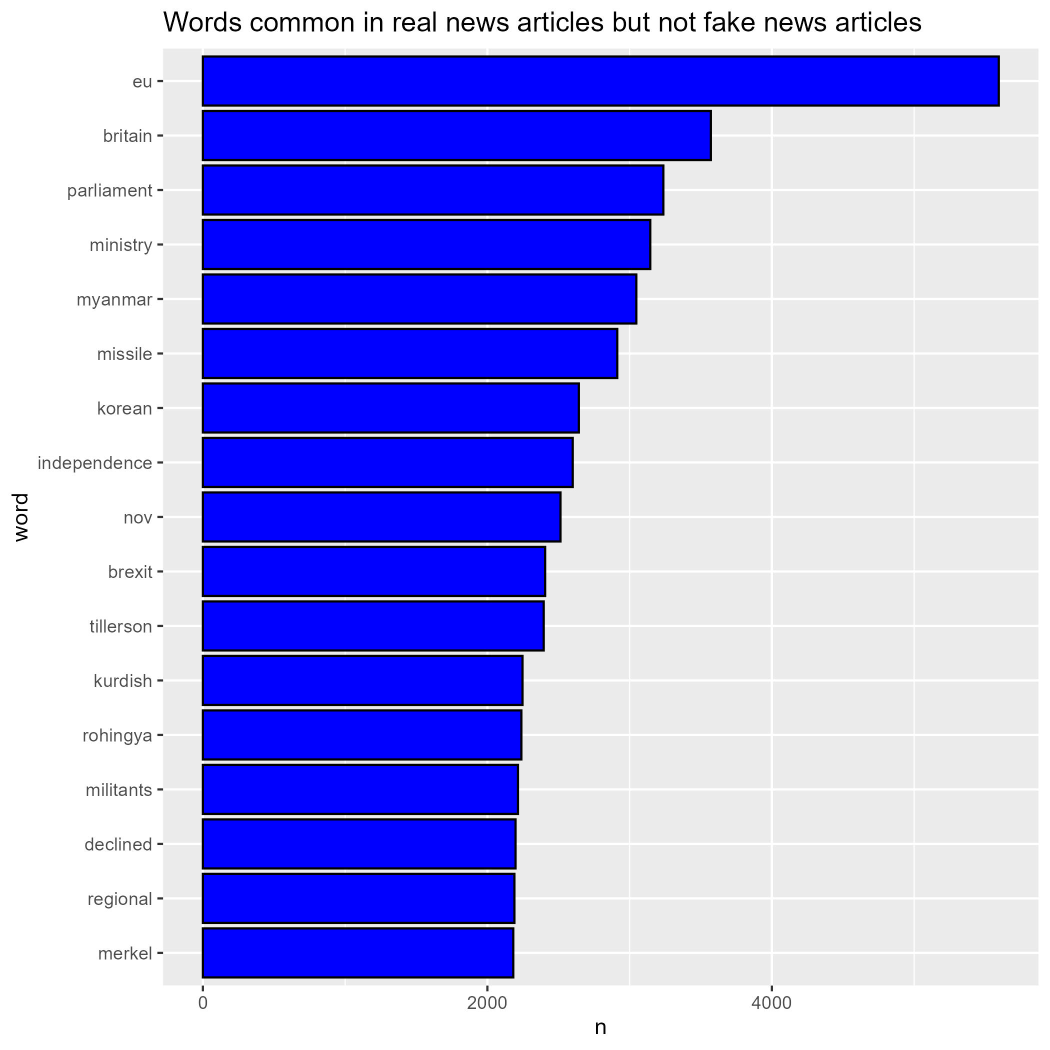
Words specific to real or fake articles
"reuters" was the most common word distinguishing real articles but it was excluded because all real articles are from reuter's website

Slide 6
Fake news detection: Results
Split data into 70% training set and 30% test set
Logistic regression model predicted correctly in the test set with an accuracy of 85% and an AUC if 0.92.
The variables from most predictive to least
words more common in fake news
words more common in true news
stop words
Positive and negative

Slide 7
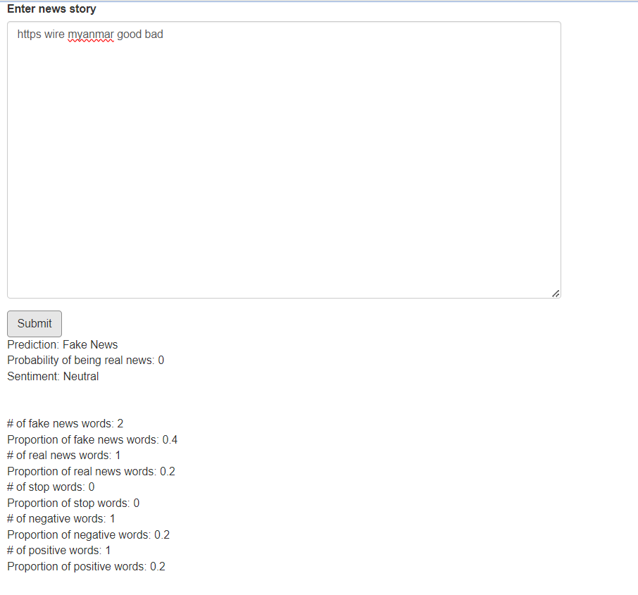
Shiny App
I created an R Shiny App with this model and you can paste text into the box and it will report the sentiment and predicted probability of being fake news

